Slide 1

WELCOME

Slide 2

LAUNDRY MANAGEMENT SYSTEM
BY:
Roshini
Nitya
Snehaja
Vasantha
Nandana

Slide 3
TITLE:DRIP N DRY
Our project is the web application which allows people to order for laundry services online.
User just order ,we pickup,we clean,we
deliver.
It is efficient and time saving than manual laundry.
It has different types of user friendly services
and facilitates easy approach.

Slide 4
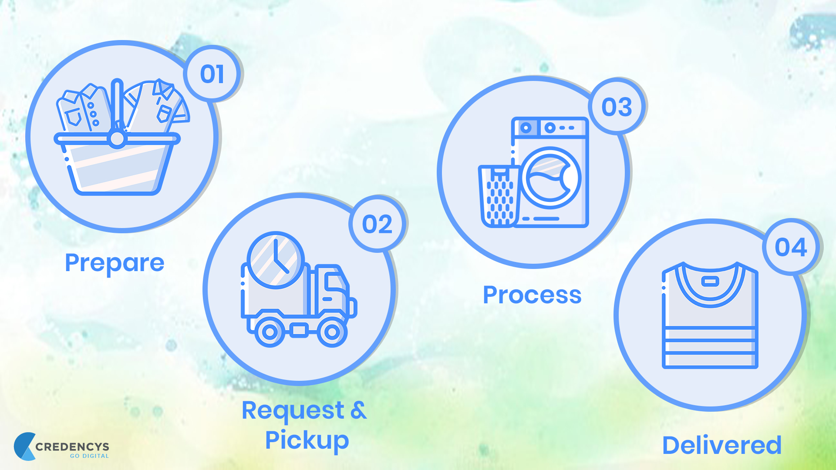
Modules :
Our project consists of following modules:
1.REGISTRATION
2.LOGIN/LOGOUT
3.PRICING DETAILS
4.WASHING DETAILS
5.ORDER
6.ADMIN APPROVAL
7.RECEIPT
8.DELIVERY

Slide 5
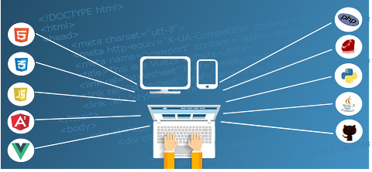
TECHNOLOGIES:
PYTHON
DJANGO
HTML
CSS
BOOTSTRAP
JAVASCRIPT
MYSQL

Slide 6

DEMO

Slide 7

QUESTIONS

Slide 8
THANK YOU

